Slide 1

Team White Executive Overview – All the buzz™
Kassidy Wall • Christy Dunlap • Blayten Jones • Spencer Anderson • Julius Hearns

Slide 2
Project Overview
Problem:
Buzzword Software is a rapidly growing company, and the marketing team wants to improve company branding and visibility
Solution:
Create a dynamic data feed, All The Buzz™, that delivers computer themed jokes, trivia, quotes, and biographies. This can be used to enhance the company's brand visibility by enriching digital experiences across internal and external platforms.
Ex: Computer trivia line to the footer of internal websites
Adding quotes or bios to outgoing newsletters
Creating a computer joke contest for marketing expos

Slide 3
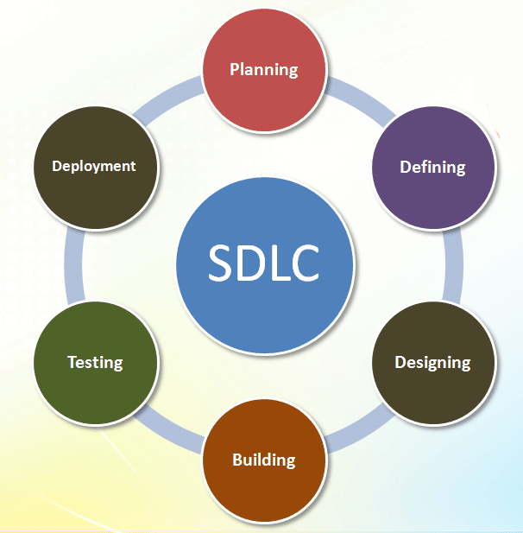
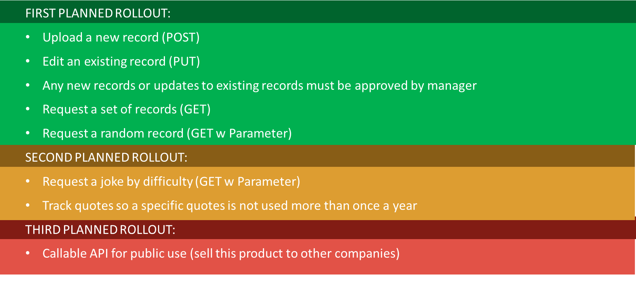
Engineering lifecycle: Planning
Gather and analyze requirements to create use cases

Slide 4
Engineering lifecycle: Defining
Define our primary, secondary, and tertiary users
Primary Users
Secondary Users
Tertiary Users
Marketing Team
Managers
Event Planners
IT Support
DBA
Legal
HR
Define our project scope and constraints
Company intranet
Marketing emails
Company newsletters
Events like joke contests at expos
REST HTTP requests/response
Authentication server must be running
4-week timeline

Slide 5
Engineering lifecycle: Defining
Define what success looks like and how we should measure it
How many people are using our software?
01
Is the API diverse enough?
02
Are our use cases properly working?
03
Is it secure?
04
Define security risks and possible solutions
Database Injection?
Table Tampering?
Token Expiration?
Role Based Access?
Error Message Injection?
Overflow Attacks?
Code Injection?
DDoS?
Data Sanitization
Strict Field Rules
REST Authentication
REST Authorization
Scrub Error Message
Input Validation
Checksum Validation
Rate Limiting

Slide 6
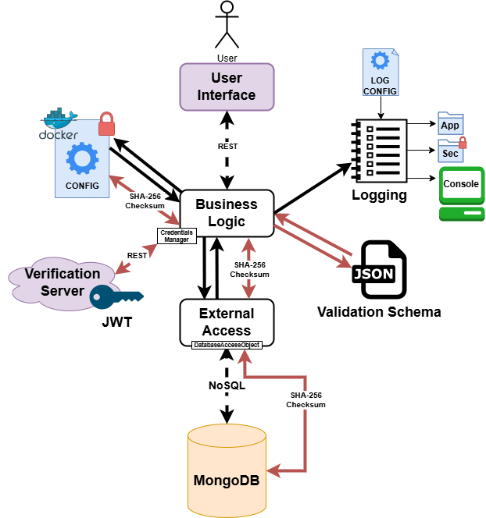
Engineering lifecycle: Designing
Design project architecture and establish trust boundaries

Slide 7
DFD: Add Record as Manager
Json token, record content
Submits POST/Content_Public
Authentication Server
Send Authentication
Error Message
no
Valid Token?
* Key Takeaways
Record describes either:
Joke
Trivia
Bios
Quotes
Record gets added to public collection
yes
Data Sanitization/
Input Validation
Our API
Error Message
no
Valid
Input?
yes
Error Message
no
Valid
Checksum?
Check Position Again
yes
DB
Add to Content_Public Collection

Slide 8
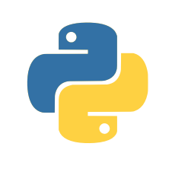





Engineering lifecycle: Designing
Decide on tools and libraries
pymongo – communicate with the DB
logging – built-in logging library for python
pytest – testing library for python
Flask – program architecture/framework
pyyaml – config read/writes

Slide 9
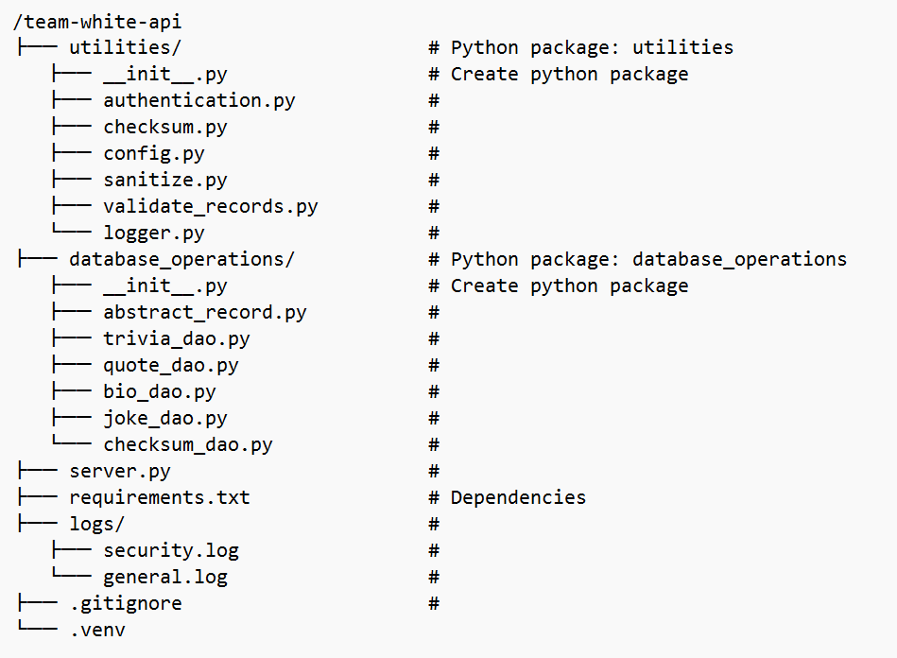
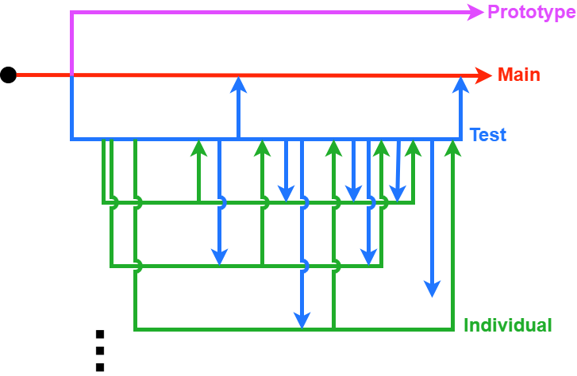
Engineering lifecycle: Building
Build project organization and workflow
Still in progress

Slide 10

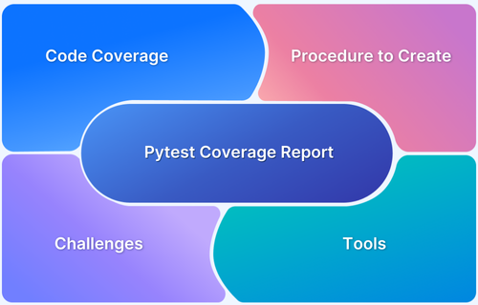
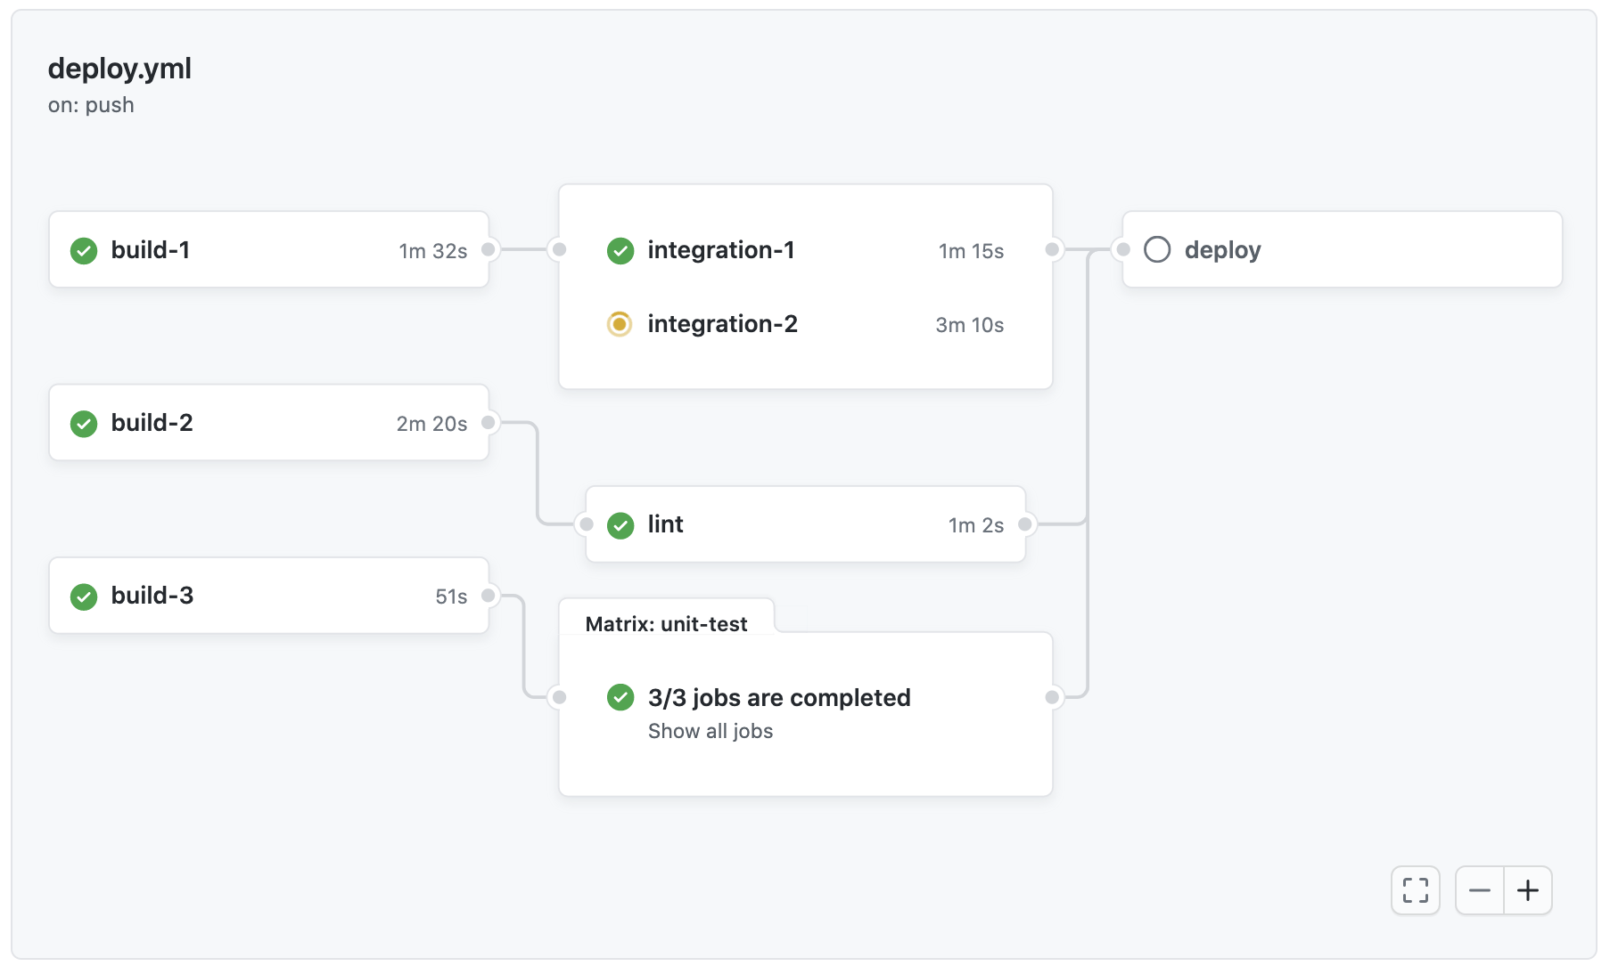
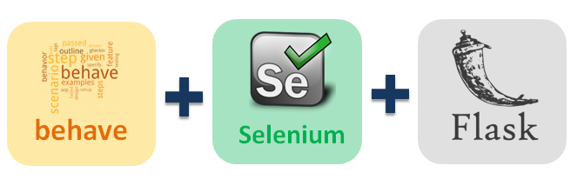
Engineering lifecycle: Testing/Deployment
Performing unit tests, integration tests, and load tests.
Create a CI/CD pipeline with Github actions

Slide 11

Thank you!
Any questions?

Slide 12
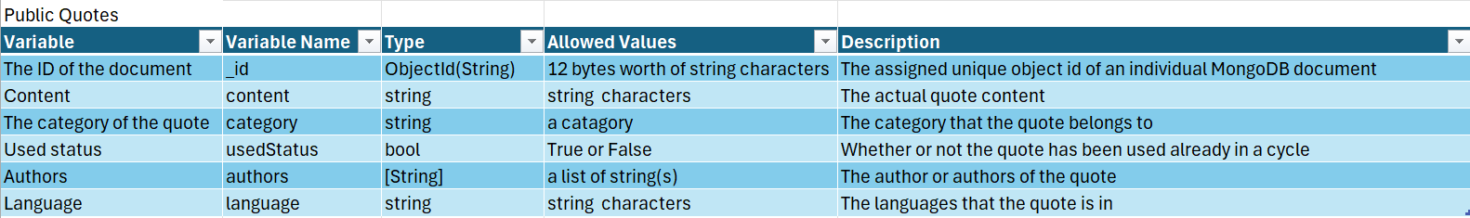
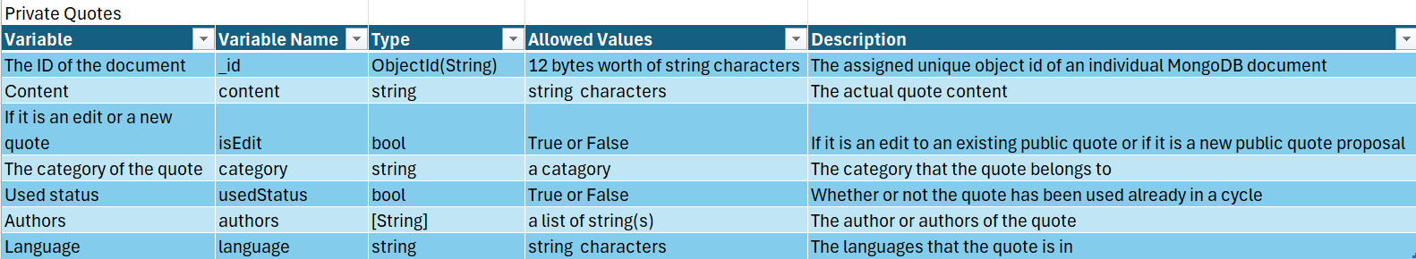
Data Dictionary

Slide 13
Requirements / Use Cases

Slide 14
Success Metrics
How many people are using our software?
01
Is the API diverse enough?
02
Are our use cases properly working?
03
Is it secure?
04

Slide 15
Security Risks + Solutions
SQL Injection?
Table Tampering?
Token Expiration?
Role Based Access?
Error Message Injection?
Overflow Attacks?
Code Injection?
DDoS?
Data Sanitization
Strict SQL Field Rules
REST Authentication
REST Authorization
Scrub Error Message
Input Validation
Checksum Validation
Rate Limiting

Slide 16
Architecture
Trust boundaries

Slide 17
Python
High Industry Longevity
Team Comfortability
Pairs with Flask
Readable + Maintainable
Allows for Testing
Version 3.12.10

Slide 18
Engineering lifecycle: Designing
Submits POST/Content_Public
Authentication Server
Send Authentication
Error Message
no
Valid Token?
Design dataflow diagrams
yes
Data Sanitization/
Input Validation
Our API
Error Message
no
Valid
Input?
yes
Error Message
no
Valid
Checksum?
Check Position Again
yes
DB
Add to Content_Public Collection

Slide 19

MongoDB (NoSQL)
High Scalability
None Relational
Flexible fields
Stores Binary JSON (perfect for REST APIs)

Slide 20

Flask
Flexible Routing for API design
Helps provide a product Framework
Works well with MongoDB (over Django)
More Customization

Slide 21

Libraries
pymongo – communicate with the DB
logging – built-in logging library for python
pytest – testing library for python
Flask – program architecture/framework
pyyaml – config read/writes

Slide 22
Organization
3 packages
13 modules

